Slide 1

JULY 2024
WAYNE COUNTY
July Newsletter Contents
Richard Wooten
MSU Extension – Wayne County District Director
Diane Wisnewski
4-H Supervisor
Laurie Rivetto
4-H Educator
Ashleigh Apel LaToya Jones
4-H Program Coordinators
Waverly Eubank Holly Sysol
4-H Program Instructors
• Wayne County Current Events
• Wayne County Announcements
• Wayne County 4-H’er Spotlight
• Wayne County Success Story
• Statewide Calendar of Events
• Statewide 4-H News
(313) – 494 – 4797 (Focus Hope)
(734) – 721 – 6576 (Western Wayne)
https://www.canr.msu.edu/wayne/
https://www.facebook.com/MI4HWayne

Slide 2
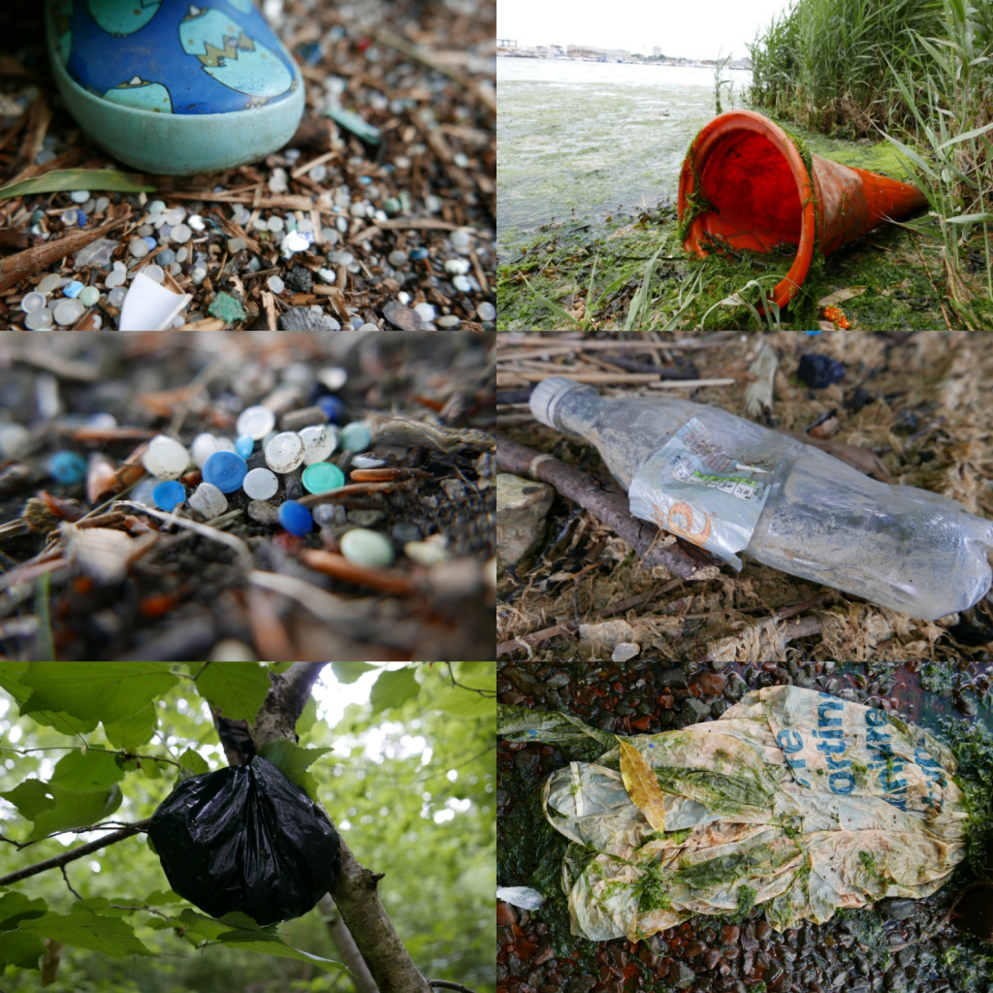
Wayne County Current Events
Flat Rock Library Water Pollution 4-H Spin Club
Come join us in this free 4-H Club about water pollution. Youth will get to explore how water pollution occurs and its effects on the environment through hands-on, engaging, and STEAM-based experiments in each class session. Youth will learn about how they can protect clean water from pollution and how they can make a difference in their community. *Free – Youth Ages 10 – 13
Registration Link: https://forms.gle/mF1b1LFdGeX91bVm9
Date and time: Wednesdays, June 19, 26; July 3, 10, 2:00 p.m. – 4:00 p.m.
Location: Flat Rock Public Library, 25200 Gibraltar Rd, Flat Rock, MI 48134
Contact: Megan Richendollar (4-H Program Assistant) richend4@msu.edu
Taylor Library Water Pollution 4-H Spin Club
Come join us in this free 4-H Club about water pollution. Youth will get to explore how water pollution occurs and its effects on the environment through hands-on, engaging, and STEAM-based experiments in each class session. Youth will learn about how they can protect clean water from pollution and how they can make a difference in their community. *Free – Youth Ages 9-14
Registration Link: https://forms.gle/wEJkUPZotxxamshPA
Date and Time: Tuesdays, July 30th, August 6th, August 13th, August 20th from 2-4pm
Location: Taylor Community Library, 12303 Pardee Rd, Taylor, MI 48180
Contact: Megan Richendollar (4-H Program Assistant) richend4@msu.edu

Slide 3
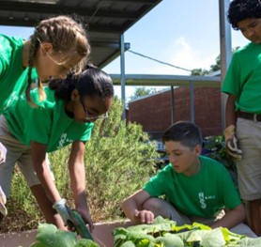
Wayne County Current Events
Cadillac Urban Gardens Stem Pathways 4-H Spin Club
Cadillac Urban Gardens Club 4-H de Verano en Carreras STEM
CLUB DETAILS:
Location: Cadillac Urban Gardens (4601 Merritt St., Detroit, MI 48209)
Dates and Times: Friday’s 1-2pm
June 14th and 28th
July 12th and 26th
August 16th and 23rd
DETALLES DEL CLUB:
Ubicación: Cadillac Urban Gardens (4601 Merritt St., Detroit, MI 48209)
Fechas y horas: viernes de 1-2pm
14 y 28 de junio
12 y 26 de julio
16 y 23 de agosto
What is 4-H?
Many people think 4-H is just for kids who live on farms or those interested in raising and selling animals – but that’s not true! Offering a diverse range of topics and interest areas, 4-H is the largest youth development organization in Michigan. 4-H provides fun, educational opportunities that empower young people with skills to lead for a lifetime and become the foundation for future success through a variety of program areas ranging from STEM, agriculture, textiles, art and more!!
STEM Pathways Summer 4-H Club
Embark on a 6-week journey and explore careers in STEM and Agriculture fields. Participate in exciting hands-on activities, learn how to build a resume, and become a true leader in your community by making positive change. By the end of this program, you will have a better understanding of various career fields in the STEM and Ag industry and feel more confident in your post-secondary education choices. Examples of the activities you will be participating in may include, but is not limited to, water pollution, robotics, engineering, geology, agronomy, and much more!
Please reach out to Ashleigh Apel, Wayne County
4-H Program Coordinator (apelashl@msu.edu) or 734-727-7
¿Qué es 4-H?
Muchas personas piensan que 4-H es solo para niños que viven en granjas o aquellos interesados en criar y vender animales, ¡pero eso no es cierto! 4-H es la organización de desarrollo juvenil más grande en Michigan y ofrece una amplia gama de temas y áreas de interés. 4-H brinda oportunidades educativas y divertidas que empoderan a los jóvenes con habilidades para la vida y el liderazgo, construyendo la base para el éxito futuro a través de una variedad de programas que van desde STEM, agricultura, textiles, arte ¡y más!
Club 4-H de Verano en Carreras STEM
Embárcate en un viaje de 6 semanas y explora carreras en los campos de STEM y Agricultura. Participa en emocionantes actividades prácticas, aprende a construir un currículum y conviértete en un verdadero líder en tu comunidad al hacer cambios positivos. Al final de este programa, tendrás una mejor comprensión de diversos campos laborales en la industria de STEM y Agricultura, y te sentirás más seguro en tus elecciones de educación postsecundaria. Algunas de las actividades en las que participarás son (pero no se limitan a): contaminación del agua, robótica,
ingeniería, geología, agronomía ¡y mucho más!
CONTÁCTANOS:
Ashleigh Apel: Wayne County 4-H Program Coordinator
apelashl@msu.edu) or 734-727-7408

Slide 4
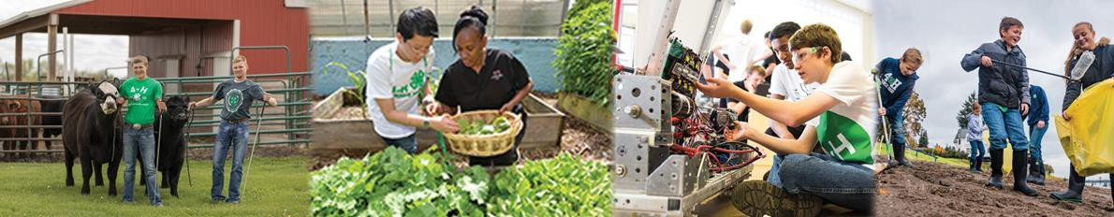
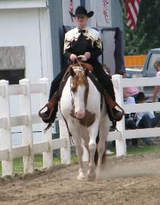
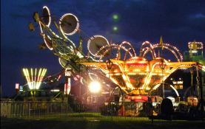
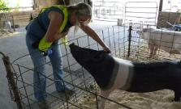
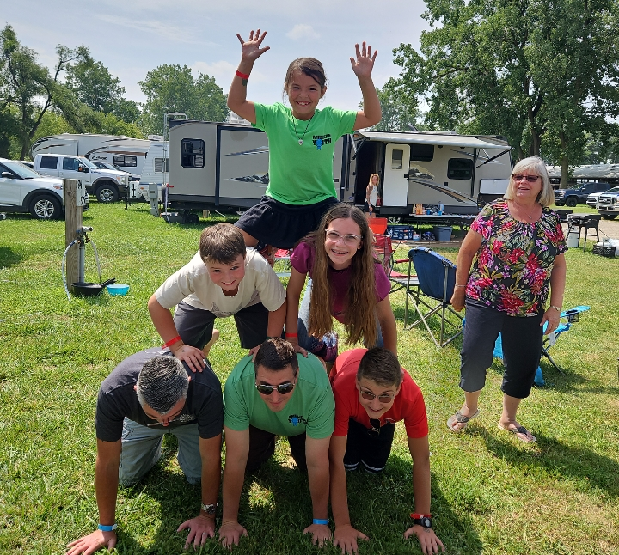
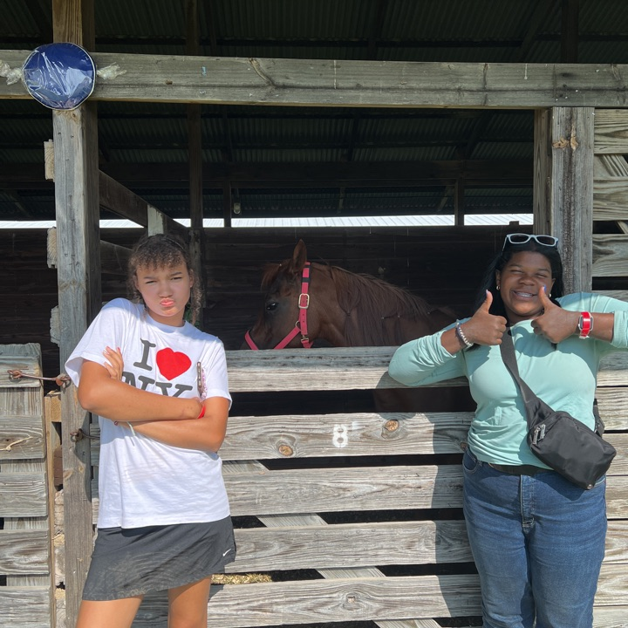
Wayne County Current Events
4-H at Wayne County Fair July 29th - August 3rd, 2024
Join us at the 78th Annual Wayne County Fair! A long-time staple of Wayne County, here you can find animals, food, rides, and of course, 4-H! Meet us to play fun fames and participate in fun activities for the whole family. Have a project you want to enter to the fair such as a painting, or your famous apple pie? Contact Ashleigh Apel apelashl@msu.edu for more details. Fair entries close July 15th.
For more information and fair brochure, click here.
Dates: July 29th- August 3rd
Location: Wayne County Fairgrounds, 10871 Quirk Rd. Belleville, MI 48111
4-H Activities During Fair Hosted by MSU Extension
4-H Power Hour Activities for 4-H youth and fair exhibitors, can take part in fun STEM activities from 1-2pm on Monday, Tuesday, Wednesday, and Friday of Fair week in the Cozadd building! Experiment with cooking food in the sun, engineering robots, and more! For questions, please ask Ashleigh Apel (apelashl@msu.edu).
We have the Annual 4-H Goose Chase during the Wayne County fair! Back by popular demand, MSU Extension 4-H will be hosting a weeklong Goose Chase for 4-H exhibitors and their families. Cash prizes are available this year for top placements. Be sure to check in with Ashleigh Apel on July 28th during mandatory fair meetings to get access to the game!

Slide 5

Wayne County Current Events
MSU Extension Wayne County 4-H Family Fun Day at DPFLI
Join US! MSU Extension Wayne County 4-H is hosting a day of fun at DPFLI . This is a FREE Event for families!
Date and Time: July 19th ~ 12-3pm
Location: 16745 Lamphere, Detroit, MI 48219
For questions: email LaToya Jones at CainJone@msu.edu.

Slide 6



Announcements
Culver’s Donation
Thank you to Culver’s of Westland for the donation to Wayne County 4-H for their “Scoops of Thanks Campaign”. A day when Culver’s Restaurants come together to give back to their local agricultural communities. Learn more here: https://www.culvers.com/stories/thank-you-farmers-project/5-reasons-to-celebrate-scoops-of-thanks-day-at-culvers
4-H Volunteer Open House
Friday, August 2, 2024, from 4:30 pm-7:30 pm at the Wayne County Fairgrounds (10871 Quirk Rd, Belleville, MI 48111) in the Cozadd building. Receive a free treat of appreciation and free parking/entry into the county fair, pick up club leader packets, meet MSU Extension staff and more!
Help Needed at the 4-H Booth During Fair!
Want to help at the MSU Extension 4-H Booth during the Wayne County Fair as a volunteer? Contact Ashleigh Apel (apelashl@msu.edu) or 734-727-7408 to find out about opportunities- July 31- August 3, 2024.

Slide 7

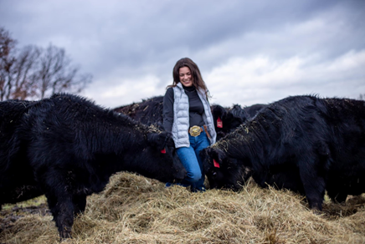
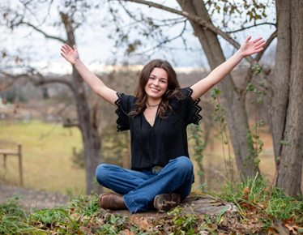
4-H’er Spotlight – Sandy Brand Memorial Scholarship
Congratulations to Caoilainn J. for winning the Sandy Brand Memorial Scholarship. Each year a deserving Wayne County youth who is or is planning to attend Michigan State University is eligible to apply. Caoilainn will be attending MSU as a freshman in the Fall in the Animal Science program and is eager to continue her education in Agriculture, and into her future career. Caoilainn owes her success and passion for Ag to 4-H. She says “If it weren't for 4-H, I would not have been given any of the opportunities to grow and become the person I am today. Being a part of 4-H has not only taught me valuable skills but has also instilled in me a sense of responsibility, leadership, and compassion. It's not just about the goats; it's about the community, the friendships, and the personal growth that comes with being involved in such a wonderful organization."

Slide 8
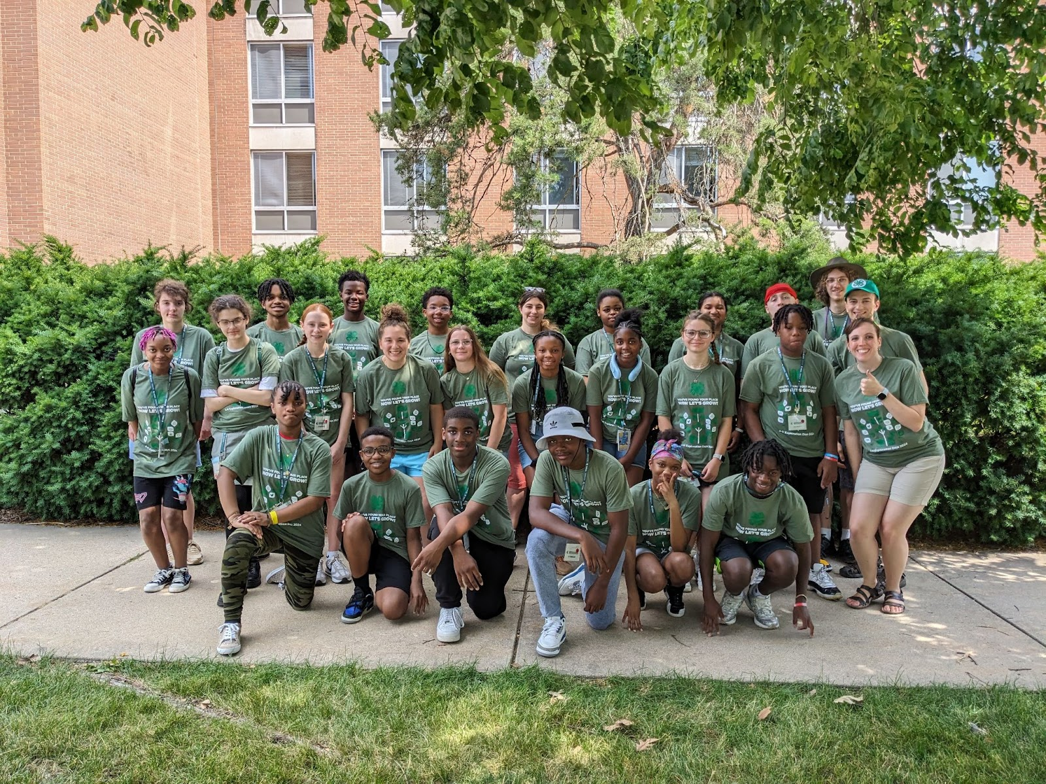
Wayne County Success Story
4-H Exploration Days
This year Wayne County had 23 delegates attend 4-H Exploration Days on MSU’s Campus, which is more than double last year’s participation. The program took place June 19th - 21st and was geared for middle schoolers and high schoolers to have the ultimate pre-college experience. Youth participating were able to take a variety of sessions that sparked their interests and helped them learn essential life skills. This program helped youth in the following areas:
  Increase responsibility, confidence, independence, accountability, problem-solving, decision-making and time management skills.
  Increase communication, teamwork, citizenship, and leadership skills.
  Foster ability to meet new people and make new friends from different places and backgrounds.
  Develop and expand career and personal interests.
  Increase college exploration and access to the Michigan State University campus and its resources.
  Develop social and academic skills needed for a successful transition to college and life as an adult.
  Give youth opportunities to try things that aren’t available in their county.
Quote from Hayden M. (11th grade participant): “I really enjoyed my classes, especially the leadership and budgeting ones because those are skills I really need and wanted to learn when I came to this event because we don’t really get to learn that type of thing in schools.”
Picture of the 2024 Wayne County 4-H Exploration Days Delegation.

Slide 9

Support 4-H when you shop JOANN
4-H Days!
July 9-10: Saginaw Bay Fish Camp
Bay City State Park, Bay City
All campers will receive a fishing rod with a reel, tackle box, t-shirt and snacks. Youth will learn about knot tying, tackle crafting, casting, aquatic ecology, angler ethics and more! Open to 4-H members ages 8-12.
www.canr.msu.edu/events/saginaw-bay-4-h-fish-camp-bay-county-2024
July 15 – August 12: Guiding Principles for Highly Successful Parenting Webinar Series
Online
Guiding Principles is a free online course for parents of toddlers to teens to learn strategies for helping children, parents and families be successful. This series will meet online each Monday for five weeks from 7:30 – 9 p.m.
www.canr.msu.edu/events/guiding-principles-for-highly-successful-parenting-webinar-series-july-2024
July 15-19: 2024 Michigan Dairy Expo and Michigan 4-H Youth Dairy Days
MSU Pavilion, East Lansing
Join 4-H members from around Michigan at the MSU Pavilion for Michigan 4-H Youth Dairy Days! Dairy Days is part of Michigan Dairy Expo, a celebration of dairy farmers and dairy cattle in the Great Lake State.
www.canr.msu.edu/events/2024-michigan-4-h-youth-dairy-days
July 18: Water Day at the Children's Gardens
Michigan 4-H Children's Gardens, East Lansing
Come cool off from the summer heat and have fun in the garden with water. We will play water games, do water art and explore all things fun about water. Come ready to get wet!
www.canr.msu.edu/events/water-day
July 25: Bug Day at the Children's Gardens
Michigan 4-H Children's Gardens, East Lansing
We cannot get enough of these amazing six-legged friends! Join us for a tribute to insects in the gardens. We will be collecting bugs, observing bugs and even making bugs! Our friends from the MSU Bug House will be back this year with their collections of insects from all over the world!
www.canr.msu.edu/events/bug-day
July 26: Discover 4-H
Catalpa Oaks County Park, Southfield
A free fun family event open to the public with fun and educational activities for the whole family! Join for games and a variety of interactive, hands-on activities brought to you by MSU Extension,
4-H and local organizations!
www.canr.msu.edu/events/discover-4-h
Wherever your imagination takes you, let our partners at JOANN help!
You can support 4-H'ers with a trip to JOANN on their 4-H Days, July 20 - 21. On these days, donations made from purchases made using a 4-H Rewards Discount Card will be doubled (from 5% to 10%).
Want to learn more about 4-H Rewards Discount Cards? Current 4-H families, alumni, volunteers and staff can save 15% off total in-store and online purchases every day with 4-H Rewards. Visit www.joann.com/4-h to learn more and enroll.

Slide 10

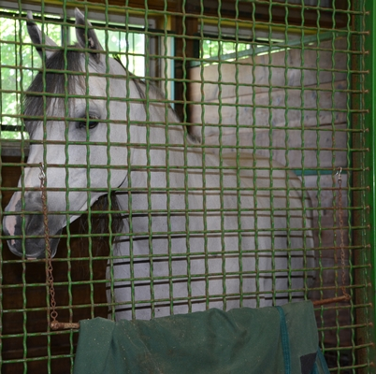
Join the Michigan State Fair 4-H & Youth Virtual Showcase!
MSU Extension is thrilled to partner again in 2024 with the Michigan State Fair on an exciting program for Michigan youth: the Michigan State Fair 4-H & Youth Virtual Showcase. This statewide showcase provides a virtual platform for youth across Michigan to exhibit their work in all project areas and apply for up to $10,000 in scholarships. Any Michigan youth ages 5-19 is encouraged to participate; 4-H membership is not required.
Registration for this event is now open! The diverse array of classes celebrate all the projects and programs in which youth have developed skill and mastery. This includes livestock and animal showmanship classes, as well as still exhibits, educational projects and more.
There is no cost to participate and youth may engage in as many classes as they wish by submitting project photos and videos. Be sure to submit your entries by the registration deadline of August 10. Project evaluation will occur before the start of the Michigan State Fair so that winners can be announced at the event which occurs August 29 – September 2.
In addition to the opportunity to showcase their skills, recognize their accomplishments and receive constructive feedback for growth and development, participants in the Michigan State Fair 4-H & Youth Virtual Showcase will also have the opportunity to apply for $10,000 in scholarships. Learn more, find helpful resources and registration links at www.canr.msu.edu/virtual-showcase/State-Fair-Virtual-Showcase/.
Going home: Biosecurity tips for animals that travel off the farm
Adapted from: https://www.canr.msu.edu/news/biosecurity_tips_for_animals_that_went_to_the_county_fair.
Animals that are exhibited at the county fair, jackpot shows, and other exhibitions are likely near and dear to their exhibitor’s hearts.
Michigan State University Extension offers these biosecurity steps exhibitors can take to protect their show animals and those that were left at home once the event has ended.
Keep animals that left home separate from animals that did not for a minimum of 14 days. If at all possible, do not allow nose-to-nose contact and provide as much distance between animals.
Disinfect all buckets, feeders, tools and footwear that left home.
Throw away any feed or hay that left home.
Always wear clean clothes and footwear. Boot coverings may be helpful when caring for isolated animals.
Take care of animals that stayed home from the show first, and animals that were at the show second. Do not go back and forth between animals as this increases the risk of cross-contamination.
Do not eat or drink in the barn.
Observe animals daily for signs and symptoms of illness, such as:
  Obvious pain or discomfort
  Decrease in appetite and water intake
  Fever
  Lethargy
  Diarrhea or changes in consistency in manure
  Discharge from nasal cavity or eyes
  Overall weakness
Care of animals after traveling is just as critical as their pre-show care. Exhibited animals were exposed to new animal populations and fair-goers, and will typically experience a lot of stress during their time away from home. By practicing these biosecurity steps, you can help keep all of your animals safe and healthy.

